Slide 1
Jupyter and Pandas
Day 10
The Data Boot Camp |
December 01, 2018

Slide 2
Jupyter Notebook

Slide 3
Definition and Usage
Jupyter is a Web Interface that allows users to run python in interactively.
It is an open-source application that allows users to create documents that contain live code, equations, visualizations, and explanatory text.
Jupyter Notebook or notebook document combines a text editor, the console, and a markdown file into one application.
Running jupyter notebook will automatically open up a webpage where users can navigate into any files/folders within the folder they ran the command from.

Slide 4
Definition and Usage Cont’d
Python files created through Jupyter Notebook end with the .ipynb extension instead of .py and cannot be easily read/altered within a typical text editor.
Jupyter provides a cell-block to write code in and be executed indenpently.
Shift+Enter to run a code block, see the output and insert and new cell-block altogether
All cell-blocks on the current editor are in one notebook document (file).
The numbers in the [ ] brackets on the left are not line/block numbers but order of random executions.

Slide 5
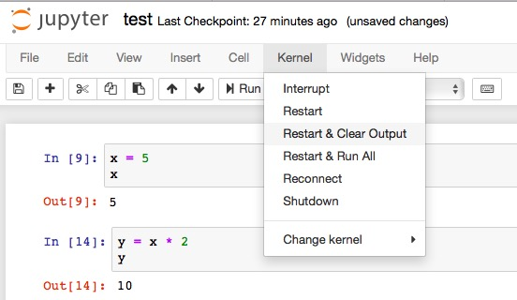
Definition and Usage Cont’d
The order of executions can be reset sequentially by activating the kernel.

Slide 6
Keys to Remember
The code within a cell can be run independently by placing the cursor inside of it and hitting Shift+Enter
If the code within a cell is not run, the changes made within will not be saved into memory
Code contained within a Jupyter Notebook is not linear. For example, if two cells modify the same variable, then whichever block of code was run last will ultimately determine the value of the variable

Slide 7
Let’s Start Coding

Slide 8
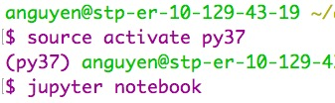
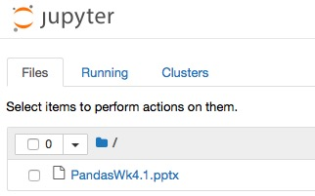
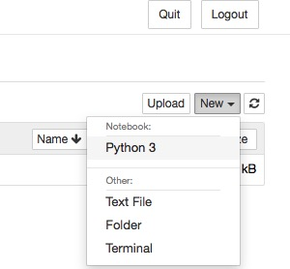
Starting Jupyter Notebook
Ensure to activate your virtual environment prior to starting Jupyter Notebook.
http://localhost:8888/tree

Slide 9
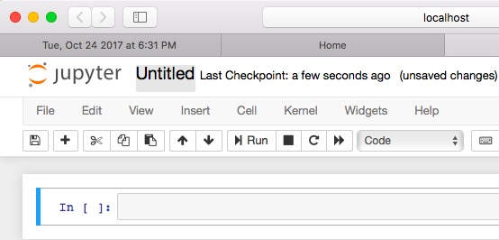
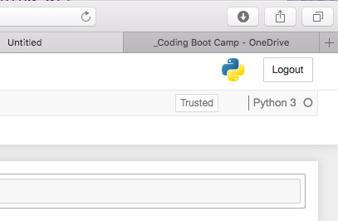
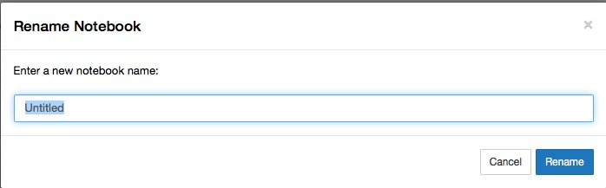
Jupyter Web Interface

Slide 10
Introduciton to pandas

Slide 11
Defnition and Usage
pandas is a software library written for the Python programming language specialized in data manipulation and analysis
It is extraordinarily powerful when it comes to visualizing, analyzing, and altering large datasets
Using Series and DataFrames instead of lists or tupples
Series is a one-dimensional labeled array, which is linear capable of holding any data type, but like a dictionary it has index which acts like a key
DataFrame is a two-dimensional labeled data structure with columns of potentially different types, similar to an Excel spreadsheet with each column being a Series

Slide 12
DataFrame - Create from Scratch
pandas.DataFrame( a list of dictionaries )
each dictionary will represent a new row:
keys = column headers
values = data placed inside the table
pandas.DataFrame( a dictionary of lists )
The keys of the dictionary = column headers
the listed values = their respective rows
Key Takeaways:
data provided must be key:value pairs

Slide 13
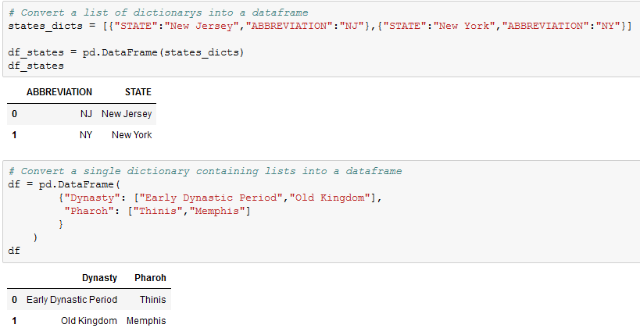
DataFrame Examples

Slide 14
DataFrame Functions

Slide 15
head() and describe()
Functions (or methods) that come packaged with Pandas allow quick and easy analysis of large datasets
.head()
takes a DataFrame and shows only the first 5 rows (by default) of data inside of it if no argument is provided
head() takes an int as argument of any values
negative value returns max rows
0 returns no rows
postive returns up to max rows
.describe()
gives an analytical overview on the table and its columns
is also helpful in showing what other data functions can be performed on a DataFrame or Series

Slide 16
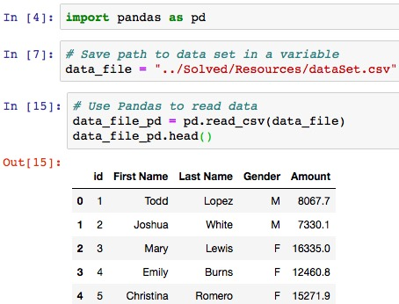
head()

Slide 17
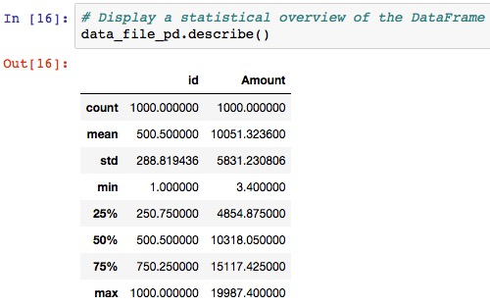
describe()

Slide 18
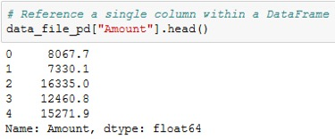
Referencing Series in a DataFrame
Most data functions can also be performed on a Series by referencing a single column within the whole DataFrame.

Slide 19
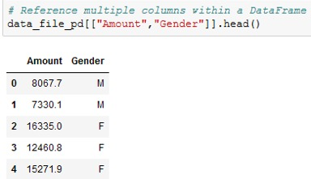
Referencing Series in a DataFrame cont’d
This is done in a similar way to referencing a key within dictionary by taking the DataFrame and following it up with brackets with the desired column's header contained within like a key

Slide 20
unique() and value_count()
unique() lists out all of the unique values stored within a column. It does so by looking into a Series and returning all of the different values within.
Syntax: DataFrame[ <series label> ].unique()
value_counts() not only returns a list of all unique values within a series but also counts how many times a value appears. The result can be viewed as an aggregation like pivot table in excel but pertain only to one column (Series).
Syntax: DataFrame[ <series label> ].value_counts()
A Series label is a key that has one or more corresponding values

Slide 21
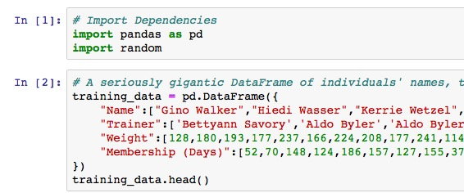
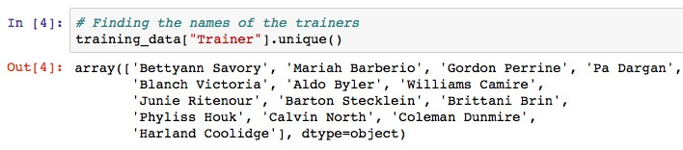
Example

Slide 22
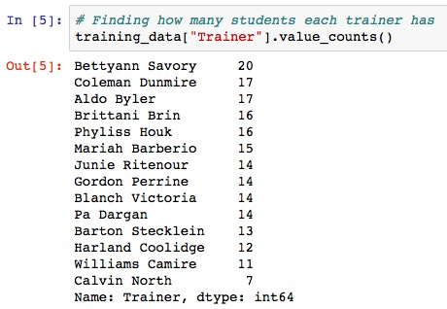
Example

Slide 23
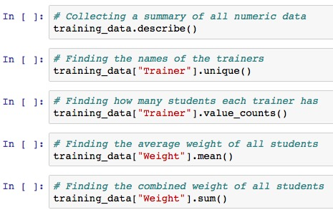
More … DF Functions

Slide 24
Columns Manipulation

Slide 25


List Available Columns
.columns returns a list of available columns in the dataframe.

Slide 26


Re-order/organize and Delete Columns
Columns can also be reordered by creating a reference to the DataFrame followed by two brackets with the column headers placed in the order desired.
newdf = origdf [ ["col2", "col4", "col1", "col3"] ]
To delete a column simply not reference them (in essence drop it from the newly created dataframe.
newdf = origdf [ ["col2", "col4", "col3"] ]

Slide 27
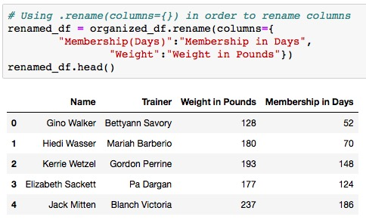
Rename Column(s)
.rename (columns = {"old_name” : "new_name”, …} )

Slide 28
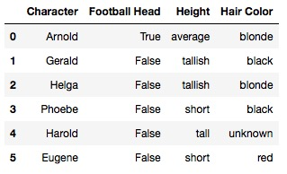
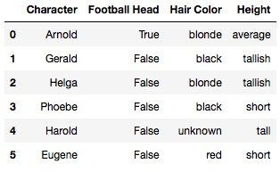
Class Activity - hey_arnold
Rename the columns
Re-organize the columns

Slide 29
Read / Write CSV File

Slide 30
Reading / Write Syntax
pd.read_csv(filename, encoding="ISO-8859-1")
encoding is optional
needed only if different than UFT-8
http://pandaproject.net/docs/determining-the-encoding-of-a-csv-file.html
https://stackoverflow.com/questions/37177069/how-to-check-encoding-of-a-csv-file
df_file = pd.read_csv(inputfile, encoding="ISO-8859-1")
Export file as a CSV, without the Pandas index, but with the header
Use the index and header parameters if part of them should be part of the table
df_file.to_csv(”outputfile.csv", index=False, header=True)

Slide 31
Questions / Discussion
Notes:
It’s important to keep in mind why you joined this class. Let’s talk about your goals.

